Slide 1
Bias in Algorithms Final Presentation

Slide 2
Automatic Race & Gender Recognition Algorithms

Slide 3
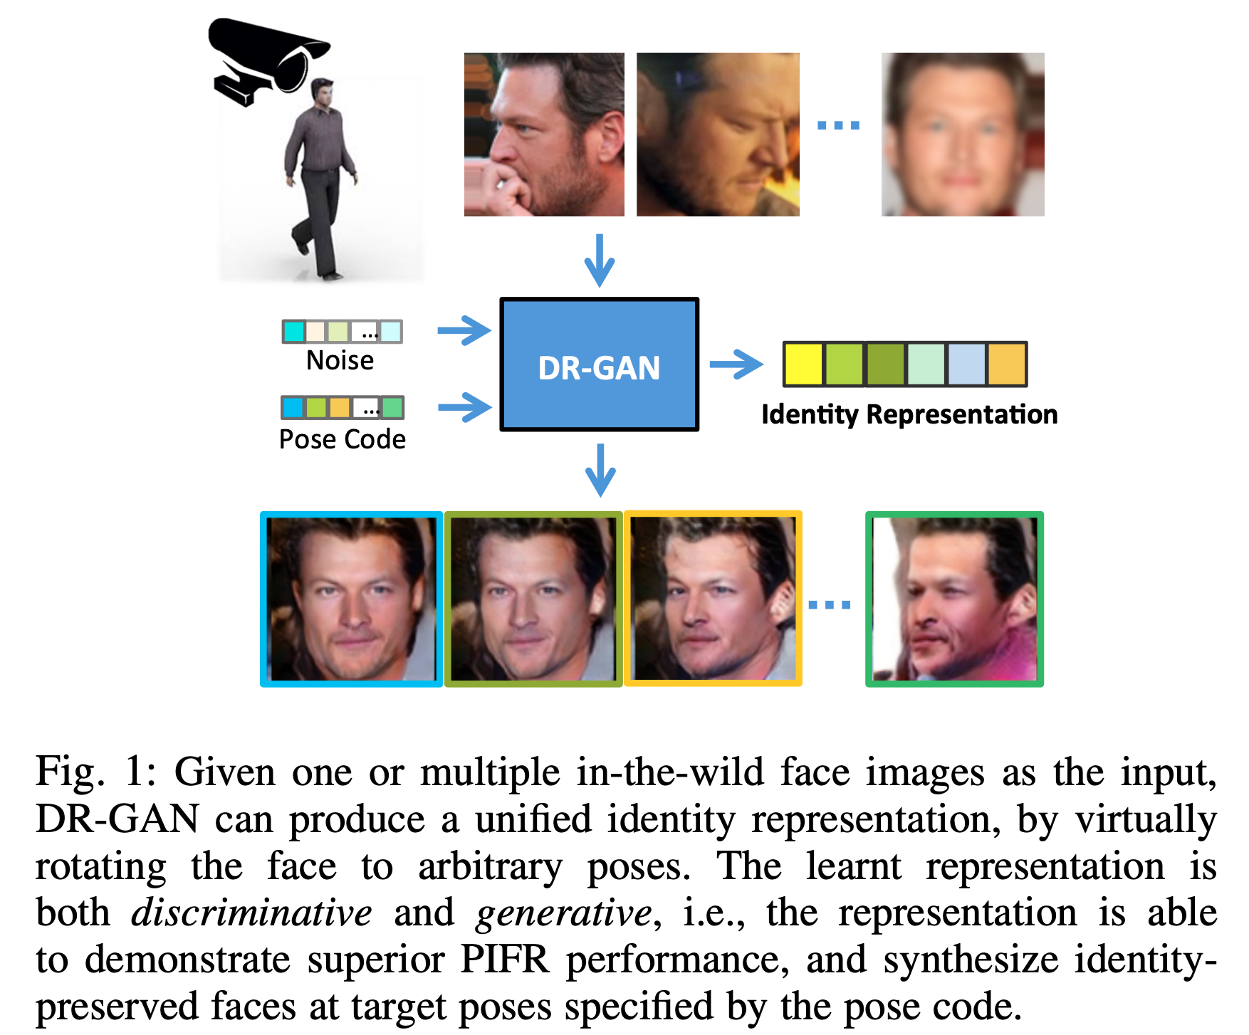
How do facial recognition algorithms work?
An image is scanned for the presence of a face, either alone or in a crowd
image can be rotated, scaled, and cropped to better highlight a face
Luan Tran, Xi Yin, and Xiaoming Liu. 2018. Representation Learning by Rotating Your Faces. In IEEE Transactions on Pattern Analysis and Machine Intelligence, September 2018. Retrieved August 7, 2019 from https://arxiv.org/pdf/1705.11136.pdf.

Slide 4
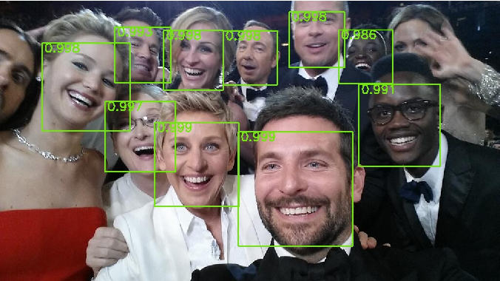
FRS 1: The bounding box
An image is scanned for the presence of a face, either alone or in a crowd
the "bounding box" holds the final image, and the confidence it contains a face

Slide 5
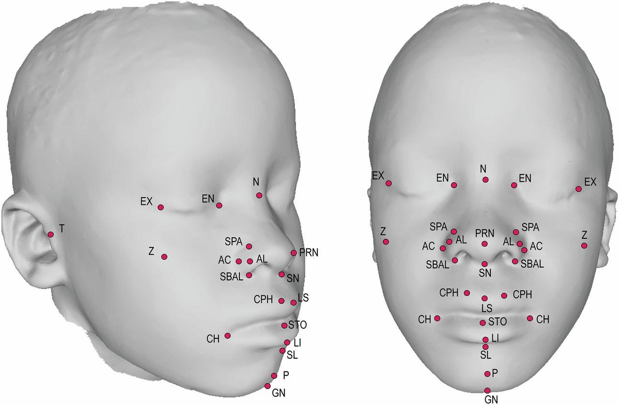
FRS 2: Facial landmarks
An image is scanned for the presence of a face, either alone or in a crowd
image can be rotated, scaled, and cropped to better highlight a face
the "bounding box" holds the final image
Facial landmarks are extracted from the image and stored in a "face template"

Slide 6
What this looks like in practice, using Rekognition
The "face template" is contained in FaceDetail:
1. BoundingBox: Bounding box of the face, and the confidence that it contains a face
Coordinates of each corner of the cropped image
2. Landmarks: Indicates the location of landmarks on the face.
Type (eyeLeft | eyeRight | nose | mouthLeft | mouthRight etc)
(x, y) coordinates of the location
3. AgeRange, Beard, Emotions, Eyeglasses, EyesOpen, Gender, Mustache, Smile, Sunglasses, etc.
A potential match is stored in PersonMatch, and an array of PersonMatches is returned.
FaceMatch: match's face ID, source image ID, confidence in the face similarity
PersonDetail: identifiers for the match, and the match's face template

Slide 7
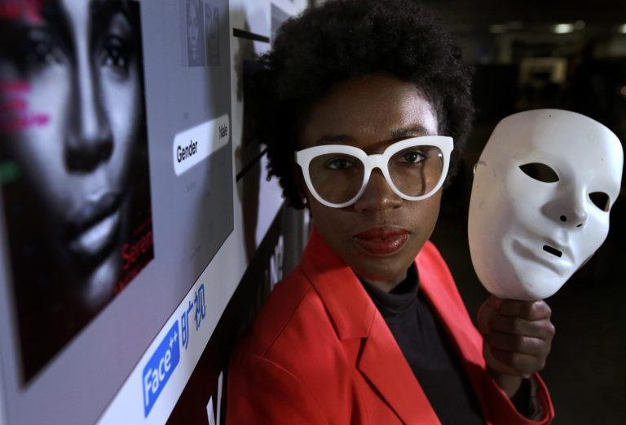
Inaccuracies are due to more than non-inclusive data sets
Joy Buolamwini, an AI researcher at MIT & founder of the Algorithmic Justice League

Slide 8
FRS 3: Determine the subject's gender
An image is scanned for the presence of a face, either alone or in a crowd
image can be rotated, scaled, and cropped to better highlight a face
the "bounding box" holds the final image
Facial landmarks are extracted from the image and stored in a "face template"
Determine the subject's gender to limit potential matches
automatic gender recognition.

Slide 9
Automatic gender recognition algorithms
"The gender recognition is essential and critical for many applications in the commercial domains...since it contains a wide range of information regarding the characteristics difference between male and female [sic]." ¹
Start with stereotypical physical differences first
Makeup, hair, etc²
Rekognition has beard and mustache objects
If the result is ambiguous, analyze...
physical build²
mannerisms²
voice pattern² and word usage¹
¹ Feng Lin, Yingxiao Wu, Yan Zhuang, Xi Long, and Wenyao Xu. 2016. Human Gender Classification: A Review. In International Journal of Biometrics (IJBM), 8, 3/4 (2016).
² C. R. Vimal Chand. 2010. Face and Gender Recognition Using Genetic Algorithm and Hopfield Neural Network. Global Journal of Computer Science and Technology 10, 1 (April 2010), 2-3.

Slide 10
The Problems
Face and Gender Recognition cites no medical journals, gender studies, or genetics studies
Human Gender Classification cites one medical journal, but it conflates gender with physiology
Both cite multiple Computer Vision and other CS studies explaining how to identify gender from mannerisms and physiology
Physiology Gender¹
Gender is a societal construct, and is not rooted in a binary
Sex is not binary
Why are stereotypes like "mannerisms" included?
Analyzing physiology to determine "gender" is very transphobic
1 Keyes, O. 2018. The Misgendering Machines: Trans/HCI Implications of Automatic Gender Recognition. Proceedings of the ACM on Human-Computer Interaction, 2, CSCW. Jersey City, NJ. Retrieved August 4, 2019 from https://ironholds.org/resources/papers/agr_paper.pdf.

Slide 11
FRS 4. Identify the face
An image is scanned for the presence of a face, either alone or in a crowd
image can be rotated, scaled, and cropped to better highlight a face
the "bounding box" holds the final image
Facial landmarks are extracted from the image and stored in a "face template"
Determine the subject's gender to limit potential matches
Identify the face:
Use distinguishing features to recognize a face in its entirety
Statistically compare the face template's metrics with template values to eliminate images with discrepancies
Either the top match or a list of potential matches is returned
automatic gender recognition.
automatic race recognition can happen here.

Slide 12
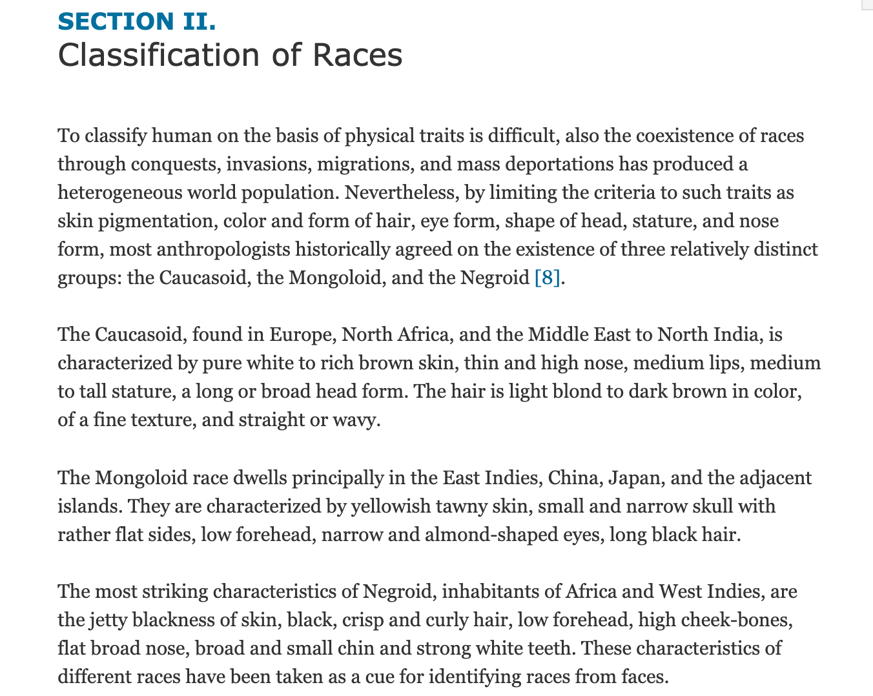
Race Classification Based on Facial Features
(This is the entire section)

Slide 13
The problems with Race Classification Based on Facial Features
Authors have CS and Engineering backgrounds, not anthropology, genetics, or even sociology
There's only one citation for the entire section, and it leads to...
Asian Face Image Database PF01: a paper about a database of 103 Asian people in various poses under different lighting
"The database is expected to be used to evaluate the technology of face recognition for Asian people"
PF01 also contains no anthropology or genetics citations, but it's just a database of images and is not trying to do terrible race science
Accepted into IEEE's 2011 Third National Conference on Computer Vision, Pattern Recognition, Image Processing, and Graphics (???????)
S. Md. Mansoor Roomi, S.L. Virasundarii, S. Selvamegala, S. Jeevanandham, and D. Hariharasudhan. 2011. Race Classification Based on Facial Features. In 2011 Third National Conference on Computer Vision, Pattern Recognition, Image Processing and Graphics. IEEE, Hubli, Karnataka, India. DOI:10.1109/NCVPRIPG.2011.19
Intelligent Multimedia Lab. Asian Face Image Database PF01. Department of Computer Science and Engineering technical report. Pohang University of Science and Technology, Korea.

Slide 14
Who is letting this happen?

Slide 15
Gender Bias in NLP

Slide 16
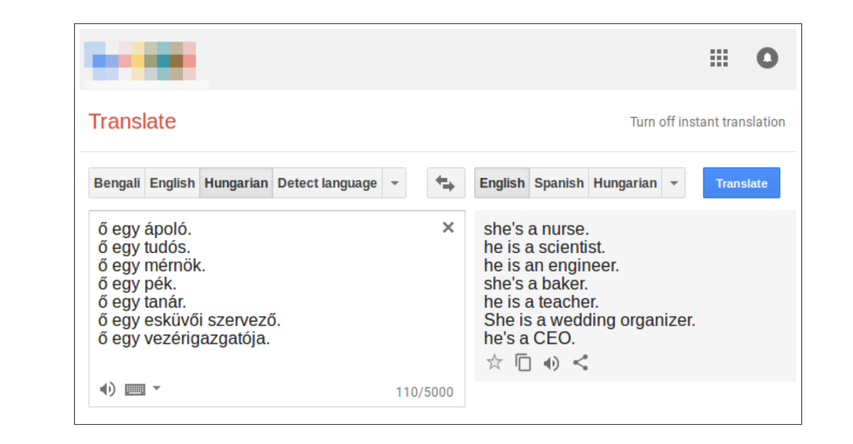
Gender Bias in Machine Translation
Study conducted by Prates et al. (2018) showed Google Translate routinely defaults to male pronouns more often than female or gender-neutral pronouns when translating
The bias towards male pronouns was especially high for fields in STEM (72%), architecture (73%), and legal services (73%), among others

Slide 17
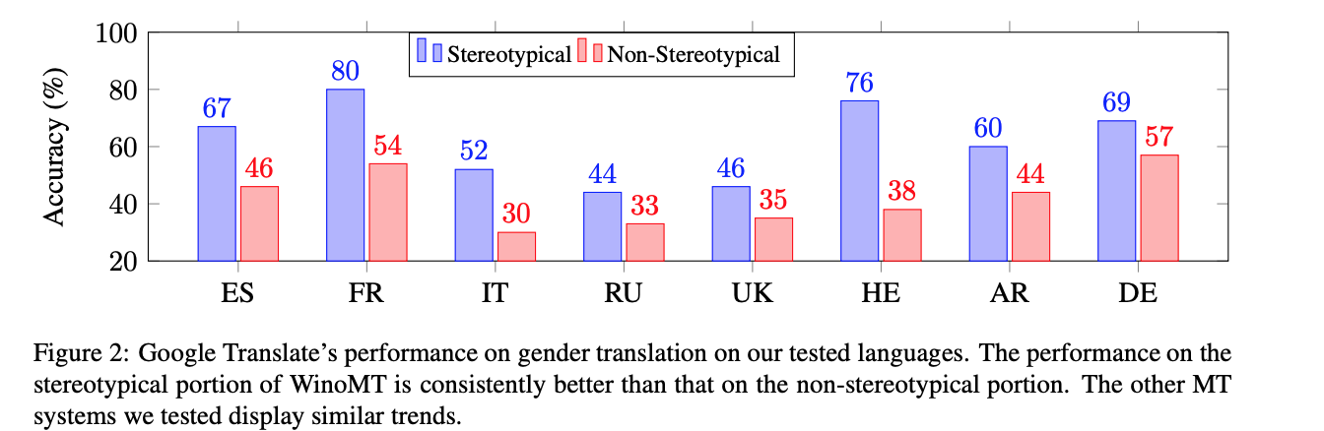
Gender Bias in Machine Translation
From Stanovsky et al. (2019). Evaluating Gender Bias in Machine Translation.
Notes:
Gender bias is obviously not just limited to Google Translate. Another research paper I read looked at Google Translate, Microsoft Translator, Amazon Translate, and SYSTRAN, as well as two academic machine translation models,and found that all of these models are significantly prone to gender-biased translation errors. They sort of took the opposite approach to the previous study, where they created a dataset of English sentences in which the subject of the sentence was cast in a non-gender stereotypical role. An example is, “The doctor asked the nurse to help her in the operation”. They then translated the sentences into eight target languages with grammatical gender, such as Spanish, French, Russian, and Hebrew.

Slide 18
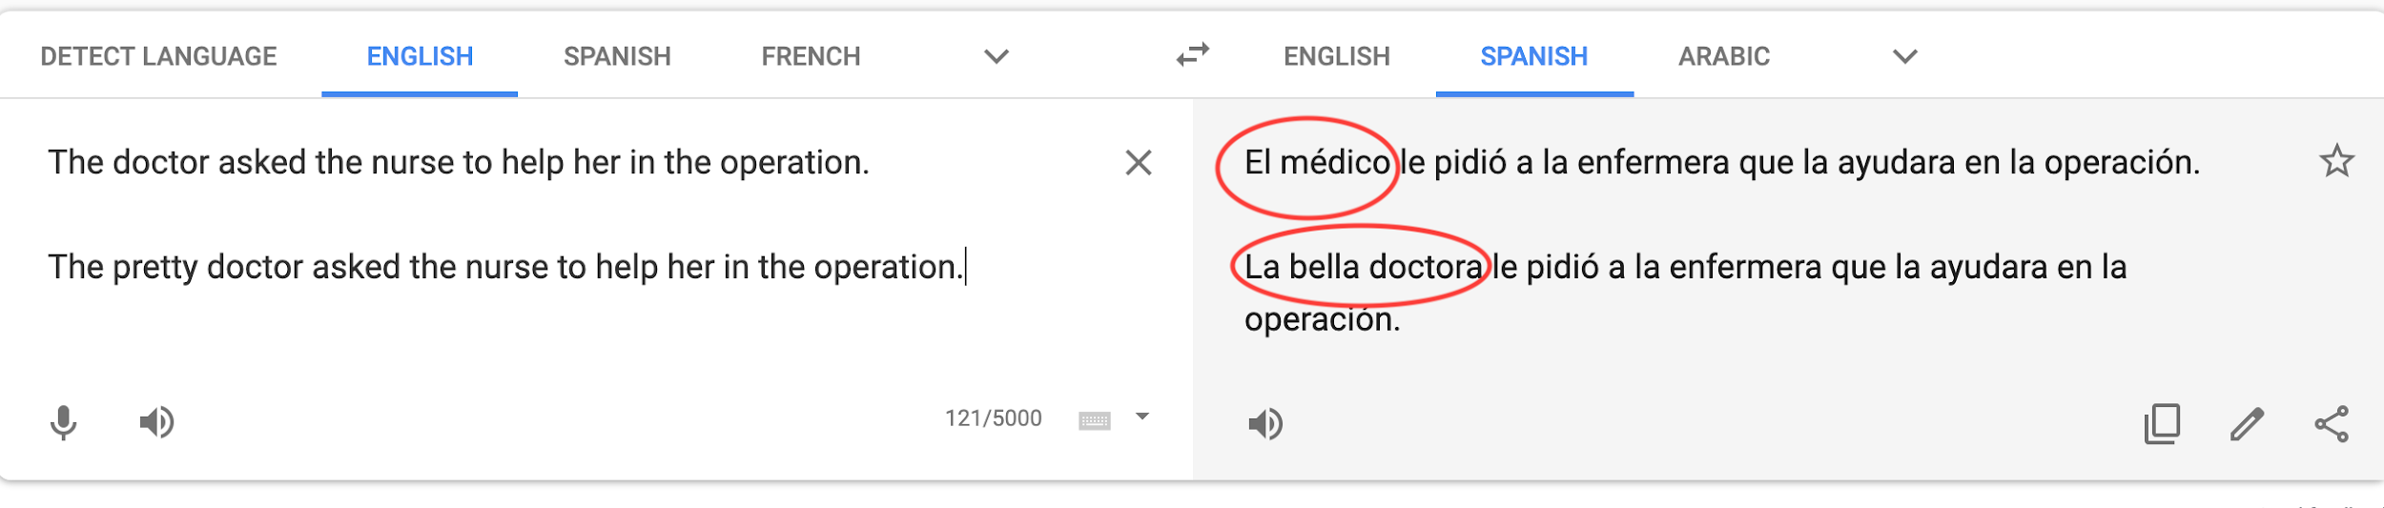
Gender Bias in Machine Translation
Observe that Google Translate defaults to the male version of ‘doctor’ when translating the sentence to Spanish
Stanovsky et al. (2019) noted that the correct gender tended to be preserved when adjectives such as “handsome” and “pretty” were prepended to male and female entities, respectively.

Slide 19
Words matter.
Nobody fed these algorithms gender demographics from the U.S. Bureau of Labor Statistics. They were trained solely on the language we use, yet still reflect deep-seated social prejudices and stereotypes.
These biases are so deeply ingrained that they are difficult to correct or eliminate.
But we need to still try.

Slide 20
Racial Bias
in
Criminal Justice

Slide 21
Algorithm Bias in Criminal Justice System
Problems / Threads | Allocation of Law Enforcement Resources | Assisting Law Enforcement in the Field | Providing Sentencing Guidelines in Court

Slide 22
Algorithm Bias in Criminal Justice System
Problems / Threads | Allocation of Law Enforcement Resources | Assisting Law Enforcement in the Field | Providing Sentencing Guidelines in Court
Lack of oversight

Slide 23
Algorithm Bias in Criminal Justice System
Problems / Threads | Allocation of Law Enforcement Resources | Assisting Law Enforcement in the Field | Providing Sentencing Guidelines in Court
Lack of oversight
Limited input from stakeholders

Slide 24
Algorithm Bias in Criminal Justice System
Problems / Threads | Allocation of Law Enforcement Resources | Assisting Law Enforcement in the Field | Providing Sentencing Guidelines in Court
Lack of oversight
Limited input from stakeholders
Biased training data

Slide 25
Algorithm Bias in Criminal Justice System
Problems / Threads | Allocation of Law Enforcement Resources | Assisting Law Enforcement in the Field | Providing Sentencing Guidelines in Court
Lack of oversight
Limited input from stakeholders
Biased training data
Difficult to eliminate bias

Slide 26
Algorithm Bias in Criminal Justice System
*Acceptance of bias
Problems / Threads | Allocation of Law Enforcement Resources | Assisting Law Enforcement in the Field | Providing Sentencing Guidelines in Court
Lack of oversight
Limited input from stakeholders
Biased training data
Difficult to eliminate bias

Slide 27
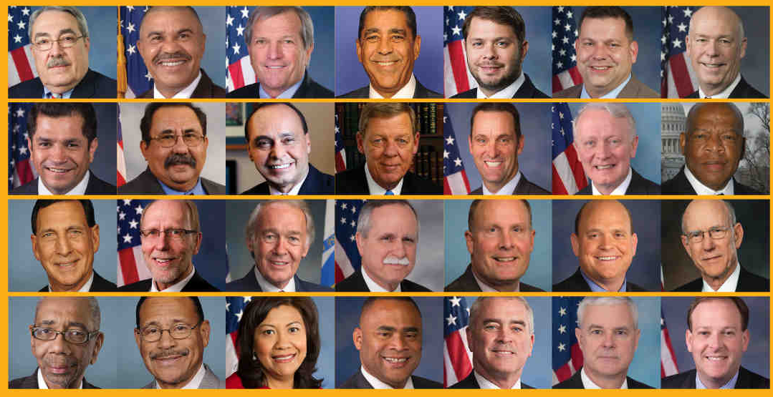
Rekognition is really bad at this…

Slide 28
Biases in Machine Learning Algorithms Using EHR Data

Slide 29
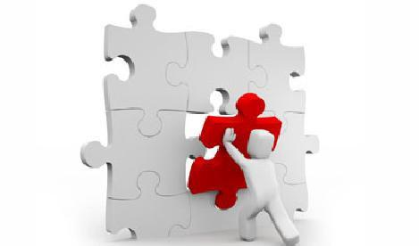
MISSING DATA
Missing Data on Race/Ethnicity, primary spoken language, primary written language.
Missing Data on vulnerable populations including those with low socioeconomic status , psychosocial issues and immigrants are more likely to visit multiple institutions or health care systems to receive care
Insufficient Data to qualify for disease definitions - patients with low socioeconomic status may receive fewer diagnostic tests and medications for chronic diseases and have limited access to health care
Algorithms generated at a single institution could be improved through the integration of larger, external data sets that include more diverse patient populations

Slide 30
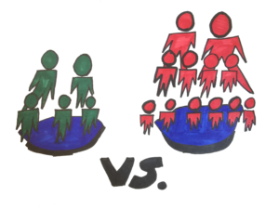
Sample Size and Underestimation
In-sufficient sample sizes
Underestimation occurs when a learning algorithm is trained on insufficient data and fails to provide estimates
Genetic studies have been criticized for not fully accounting for genetic diversity in non-European populations
Hispanic and Latino patients had lower disease connectivity patterns compared with patients of European ancestry and African Americans
Machine learning-based algorithms could misinterpret low sample size or lack of health care use as lower disease burden and, as a result, generate inaccurate prediction models for these groups

Slide 31
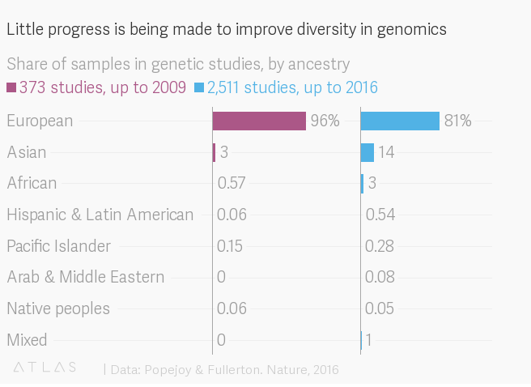
HUMAN GENOMICS STUDY

Slide 32
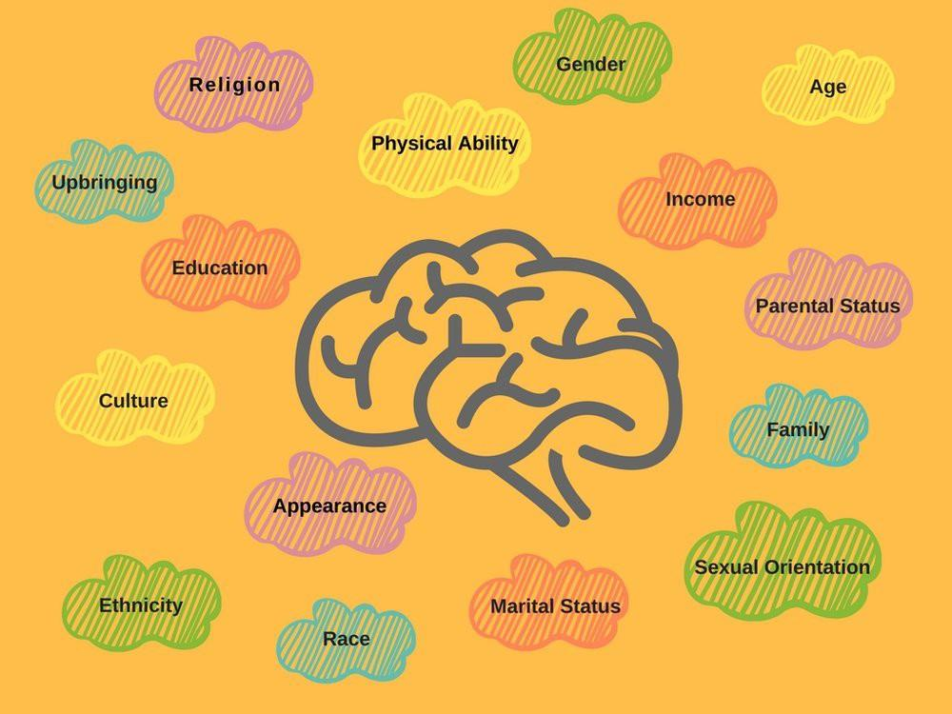
Misclassification or Measurement Error
Common sources of bias in observational studies and analyses based on data in the electronic health record - Errors by Practitioners
Quality of care may be affected by implicit biases related to patient factors, such as sex and race/ethnicity, or practitioner factors.
Individuals with low socioeconomic status may be more likely to be seen in teaching clinics, where documentation or clinical reasoning may be less accurate or systematically different than the care provided to patients of higher socioeconomic status in other settings

Slide 33
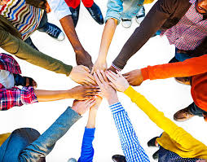
Recommendations
Identify the target population and select training and testing sets accordingly
Build and test algorithms in socioeconomically diverse health care systems
Ensure that key variables, such as race/ethnicity, language, and social determinants of health, are being captured and included in algorithms when appropriate
Test algorithms for potential discriminatory behavior throughout data processing
Develop feedback loops to monitor and verify output and validity

Slide 34
What Did We Learn?

Slide 35



Rekognition is Easy. Maybe Too Easy.
https://www.youtube.com/watch?v=f4NIuLb2QkI
Notes:
One thing that ties our topics together is Amazon Rekognition. It’s not the only FRS software out there, but as a market leader it gets a lot of attention from people who want to use it, and people who (rightly) criticize what it’s being used for. One stated goal is to provide accessible image processing for your application. A YouTube search returns dozens of videos, many from Amazon Web Services, indicating how to use Rekognition. So… I tested it. I followed this link (because I like Python) and an hour later, I was gleefully feeding pictures to Rekognition to see whether I could get it to identify the items in the pictures. And do you know what?

Slide 36

It recognized some things.
No.
It’s not Steve Irwin.
Was Rekognition able to identify this person as a “tiger trainer” or “animal trainer”?
“Labels” : [
{ “Confidence”: 95.59647369384766
“Name” : “Tiger”
}
...
{ “Confidence”: 94.79637347886473
“Name” : “Man”
}
… ]
Notes:
I had heard in one AWS video that it had the potential to identify people’s professions from images. I had seen an example where Rekognition was able to identify a tiger from an image. If I fed it an image of a “tiger trainer” would I get back anything like the right answer? Well...

Slide 37
Some Other Takeaways
Getting groups like the ACLU involved in helping the representation of currently underrepresented or at risk sections of the population is a good start. Even better would be including them without needing a third party to say “You should probably train your algorithm on group X as well, if you’re going to ever apply it to anyone within group X.”
Stakeholder involvement.
Recognition (not Rekognition).
Data Fiduciaries
Ethics Canvas
Empathy Maps
India was looking into passing a data fiduciary law which guaranteed that, in essence, you own your data, and that anyone who collects it must act in your best interest when they use that data. That includes revealing how they plan to use your data and critically, getting your OK on using it in that way. While it seems like a pipe dream in a country that can’t even guarantee us net neutrality from administration to administration, this would be a huge step in the right direction for both data privacy and the eventual elimination of data bias.
Ethics Canvas - available online at ethicscanvas.org, this can be a valuable tool in project planning, but it also can be used to identify who is and isn’t affected by the potential uses of your algorithm, or your data set, and thus who should be represented. Careful consideration can minimize the negative impact on underrepresented stakeholders.
Empathy maps - these can help to build a better understanding of the groups who are being affected by your use of data. Are they being represented? How are they going to be affected if they aren’t represented adequately?
Notes:
Chad, Trina and Annie all mentioned stakeholder involvement; we can get committed parties involved in reducing data gathering bias. Everyone brought up some data which suggests that this can be linked to societal bias - by working to reduce and recognize that bias in society, we can reduce and recognize it in our data sets. Hector Dominguez, in his presentation to the class brought up the idea of data fiduciaries (wherein people utilizing collected data must maintain their duty toward those the data was collected from); he also brought up the Ethics Canvas and Empathy Maps.

